Slide 1
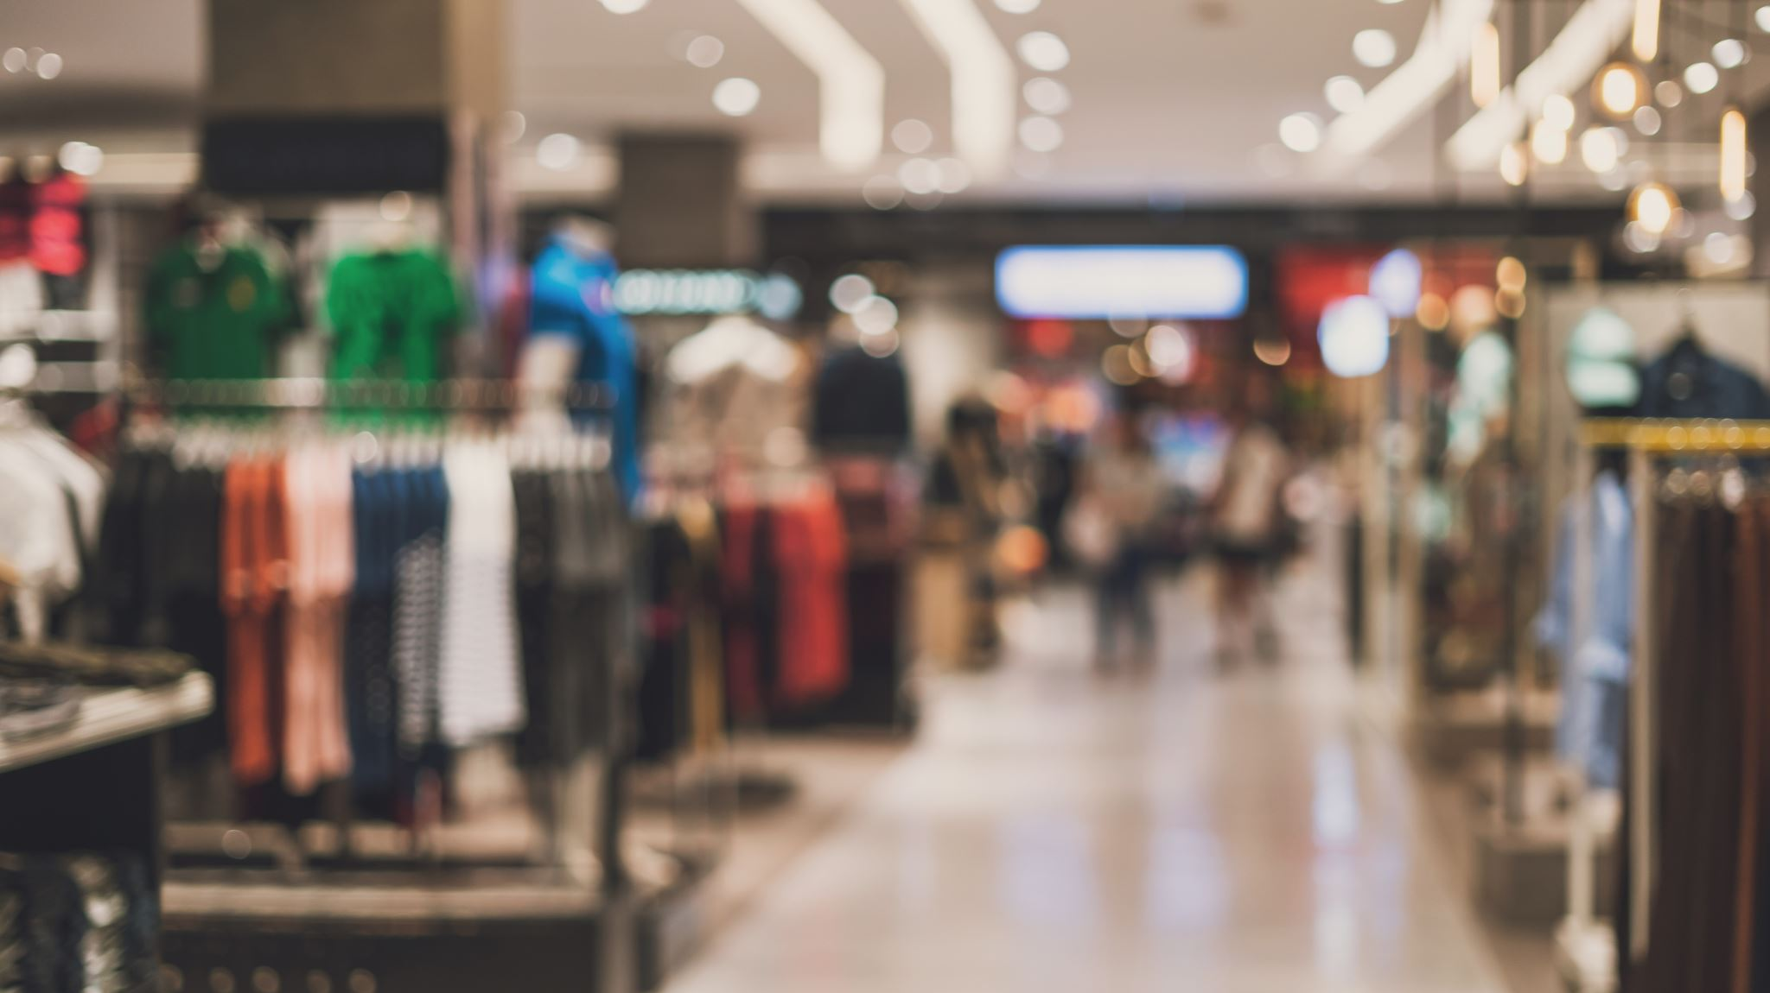
Online Super Shop Management System
Presented BY:
Md. Taofick Mahmoodur Rahaman
ID: 221-35-847
MD Mubtasim Fuad Khan
ID: 221-35-883
Md. Rakib Hasan
ID: 221-35-964

Slide 2
Introduction
The Online Super Shop Management System represents a transformative approach to the retail shopping experience, transitioning from the traditional brick-and-mortar stores to a comprehensive digital platform. This system is designed to bridge the gap between consumers and the products they need, bringing the convenience of shopping to the fingertips of users across a wide demographic. By leveraging modern web technologies, the system aims to provide an efficient, secure, and user-friendly shopping environment that caters to the needs of a diverse user base, including customers, administrators, shop managers, and delivery personnel.

Slide 3
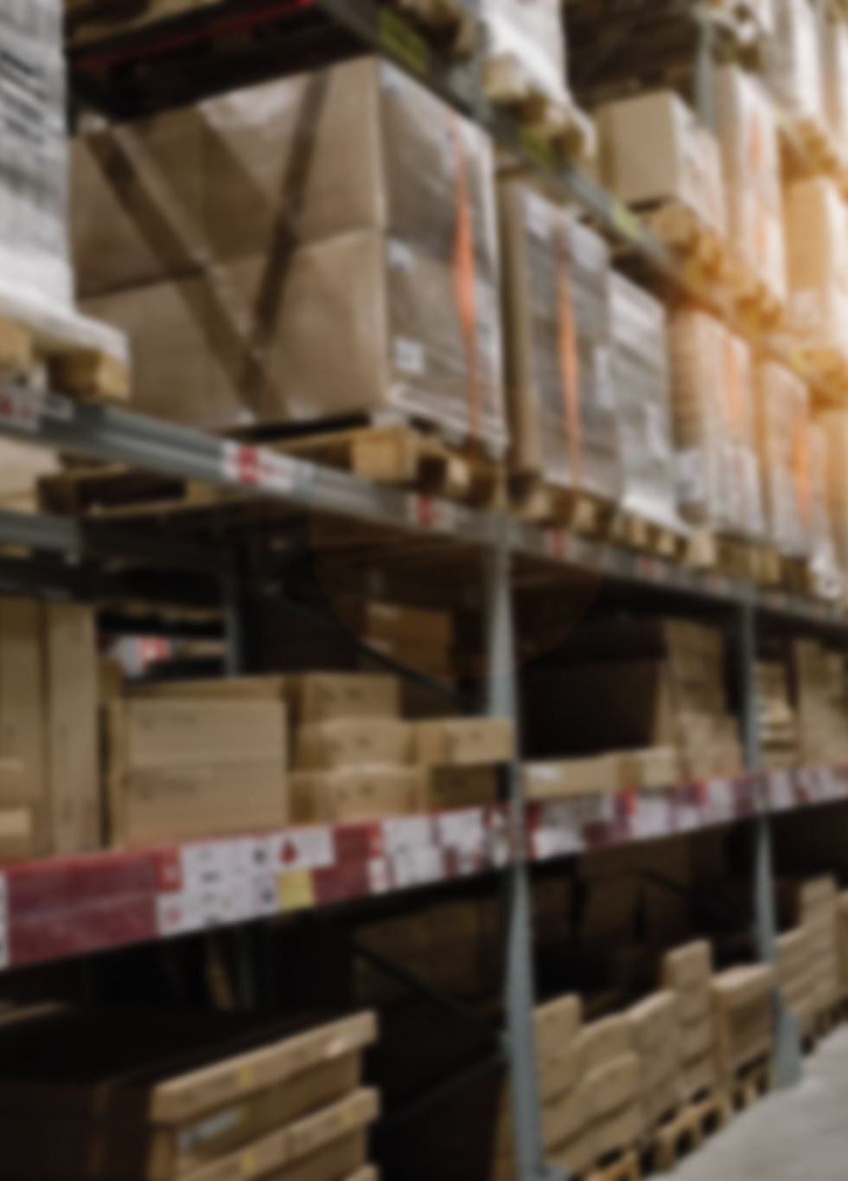
Objective
The primary objective of the Online Super Shop Management System is to enhance the shopping experience by providing a platform that is accessible, reliable, and capable of meeting the evolving demands of both consumers and businesses. The objectives include:
Seamless Online Shopping Experience
Efficient Product and Inventory Management
Secure and User-friendly Environment
Comprehensive Access and Functionality

Slide 4

Key Features
User Registration and Management
Product Browsing and Management
Shopping Cart and Checkout Process
Order Tracking and Fulfillment
Payment Integration
Product Reviews and Ratings
Notifications and Alerts
Delivery Tracking

Slide 5
Scenario Writing
Scenario-1: User Registration
Scenario Description:
Request for User Registration
Provide Required Fields
Filled fill up
Submit for Registration
Registration Successful
Scenario-2: Product Search and Filter
Scenario Description:
Request for Product Search
Select Filter Options
View Filtered Products
Product Selection
Search and Filter Successful
Scenario-3: Adding Products to Cart
Scenario Description:
Browse Products
Select Product
Choose Quantity
Add to Cart
Product Added Successfully

Slide 6
Scenario Writing
Scenario-4: Purchase Process
Scenario Description:
Request for Purchase
Provide Shipping Details
Select Payment Method
Review and Confirm Order
Confirm Order and Pay
Purchase Successful
Scenario-5: Order Tracking
Scenario Description:
Request for Order Tracking
Provide Order ID
Select Track Order
View Order Status
Order Tracking Successful
Scenario-6: Product Review and Rating
Scenario Description:
Request for Product Review and Rating
Select Purchased Product
Provide Rating and Review
Submit Rating and Review
Review and Rating Successfully Added

Slide 7

Stakeholder
The key stakeholders involved in this Online Super Shop Management are:
Customers
Shop Managers

Slide 8
User Profile-01: Customers
User Class | Notes on Characteristic
Type of User | External
Age Range | Any
Frequency of Use | Regularly
Mandatory/Discretionary | Discretionary
Computer Experience | Low to High
Operating System | Any
Applications | Web browsers, shopping app
Education | Varied
Goals | Seamless shopping experience, order tracking
Language Skills | Varied
Number of Users | Many
Training | User guides, tutorials
Other Systems Used | Various online shopping platforms
Ways of Working | Convenience-oriented, price-conscious

Slide 9
User Profile-02: Shop Manager
User Class | Notes on Characteristic
Type of User | Internal
Age Range | 25-55
Frequency of Use | Daily
Mandatory/Discretionary | Mandatory
Computer Experience | Moderate to High
Operating System | Any
Applications | Product management tools
Education | High school diploma or higher
Goals | Product and inventory management, customer satisfaction
Language Skills | Proficient in English
Number of Users | Multiple
Training | Training on product management tools
Other Systems Used | Inventory management systems
Ways of Working | Detail-oriented, customer-focused

Slide 10

Scope
User Registration and Login:
Objective: To allow users to register and log in to the system.
Functionality: Users will provide necessary information for registration. Secure authentication mechanisms will be implemented for user logins. Password recovery options will be available.
Add Profile and Update Profile:
Objective: Enable customers to create and update their profiles within the system.
Functionality: Customers can input and store personal details. Update profile information such as contact details or preferences.
Product Browsing and Selection:
Objective: Facilitate users in browsing and selecting products for purchase.
Functionality: Display a wide range of products, categorize them, and allow users to browse based on various criteria. Implement a user-friendly interface for product selection.

Slide 11

Scope
Shopping Cart Management:
Objective: Provide a convenient way for users to manage their selected items before making a purchase.
Functionality: Allow users to add, remove, and modify items in their shopping carts. Calculate and display the total cost. Save cart contents for future visits.
Order Placement and Tracking:
Objective: Streamline the process of placing orders and allow users to track their orders..
Functionality: Enable registered customers to place orders after browsing products. Provide a tracking feature to monitor the status and location of orders..
Payment Integration:
Objective: Facilitate secure and seamless online transactions for product purchases.
Functionality: Integrate a secure payment gateway supporting various payment methods such as credit/debit cards, mobile wallets, and Cash on Delivery.

Slide 12

Scope
Product Reviews and Ratings:
Objective: Encourage customer feedback and contribute to the reputation of products.
Functionality: Allow registered customers to submit reviews and ratings for products. Display aggregated ratings and reviews for each product.
Notifications:
Objective: Keep users informed about their orders, promotions, and other relevant information.
Functionality: Implement automated notifications for order updates, promotions, and other significant events. Allow users to customize their notification preferences.
Delivery Tracking:
Objective: Provide real-time tracking for delivery to enhance customer convenience.
Functionality: Implement GPS-based tracking for delivery personnel to optimize routes and provide accurate delivery estimates.

Slide 13
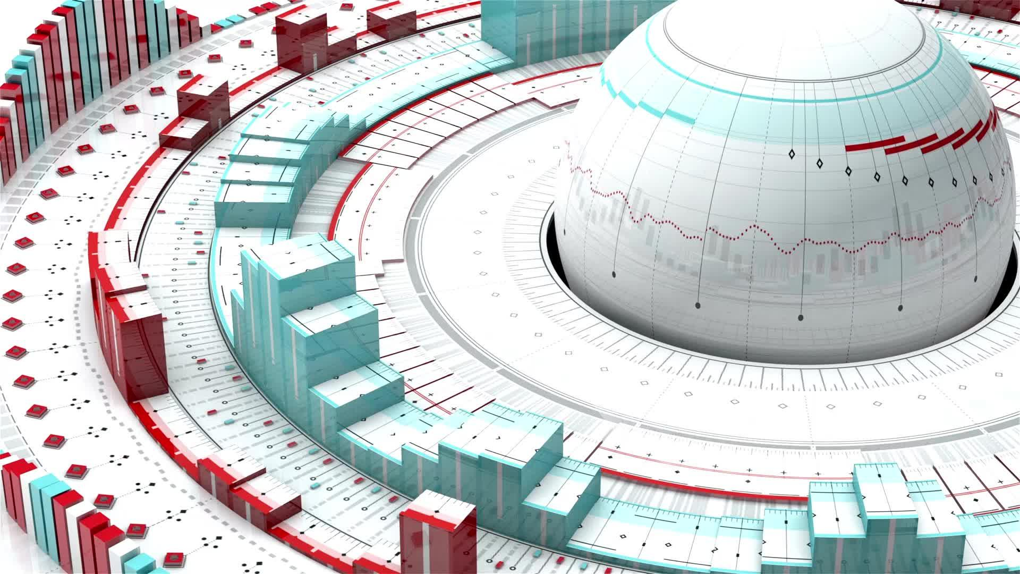
Feasibility Study
Technical Feasibility:
Hardware Compatibility: Assess compatibility with existing hardware infrastructure and potential need for upgrades.
Software Compatibility: Evaluate integration with other software, operating systems, databases, and third-party services.
Technical Expertise: Determine the availability of skilled personnel or the need for training to operate and maintain the system.
Operational Feasibility:
User Acceptance: Gather feedback from potential users (administrators, shop managers, customers) to ensure alignment with their needs and expectations.
Impact on Current Operations: Analyze how the implementation will affect current operations and identify mitigation strategies for potential disruptions.

Slide 14

Feasibility Study
Economic Feasibility:
Cost-Benefit Analysis: Conduct a comprehensive analysis of development, implementation, and maintenance costs against expected benefits (e.g., increased efficiency, improved customer satisfaction, potential revenue growth).
Return on Investment (ROI): Calculate projected ROI over a specified period, considering both tangible and intangible benefits.
Scheduling Feasibility:
Project Timeline: Develop a realistic timeline for system implementation, accounting for potential delays, testing periods, and staff training.
Dependencies: Identify dependencies on external factors (e.g., third-party integrations, regulatory approvals) that may impact the project schedule.
Security and Privacy Considerations:
Data Encryption: Confirm the incorporation of robust encryption methods (e.g., SSL) to protect sensitive information.
Compliance: Ensure compliance with relevant data protection regulations and industry standards to safeguard user privacy and security.

Slide 15
Software Requirement Specification
FR-01 | User Registration
Description | Users can register for an account by providing necessary information, including personal details and contact information.
Stakeholders | Customers, Shop Managers
FR-02 | Product Management
Description | This module enables Shop Managers to manage the inventory of products available in the online super shop. Shop Managers can add, edit, and remove product listings.
Stakeholders | Shop Managers
FR-03 | Browsing Products
Description | Users should be able to browse products based on various criteria, such as category, price range, and popularity.
Stakeholders | Customers

Slide 16
Software Requirement Specification
FR-04 | Shopping Cart
Description | A Shopping Cart module allows Customers to review and modify the items in their cart before proceeding to checkout.
Stakeholders | Customers
FR-05 | Search and Filter
Description | Users can search for products based on keywords, categories, and other filters for an enhanced shopping experience.
Stakeholders | Customers
FR-06 | Order Placement
Description | Customers can browse the product catalog, add items to the shopping cart, and place orders.
Stakeholders | Customers

Slide 17
Software Requirement Specification
FR-07 | Payment Integration
Description | The system must integrate a secure payment gateway to facilitate online transactions. Accepted payment methods should include credit/debit cards, mobile wallets, and other common forms of digital payment or Cash on Delivery.
Stakeholders | Shop Manager, Customers
FR-08 | Product Reviews and Ratings
Description | Customers can submit reviews and ratings for products, contributing to the overall feedback and reputation of items.
Stakeholders | Customers
FR-09 | Notifications
Description | The system shall send notifications to Customers regarding order updates, promotions, and other relevant information.
Stakeholders | Customers

Slide 18
Software Requirement Specification
FR-10 | Order Cancellation
Description | This feature allows Customers to cancel their orders within a predefined time frame after placing the order. The system should automatically update inventory levels and notify Shop Managers and Delivery Man of the cancellation.
Stakeholders | Customers, Shop Managers
FR-11 | Delivery Tracking
Description | The system should provide real-time GPS tracking for delivery men to optimize routes and provide accurate delivery estimates.
Stakeholders | Customers, Shop Managers

Slide 19
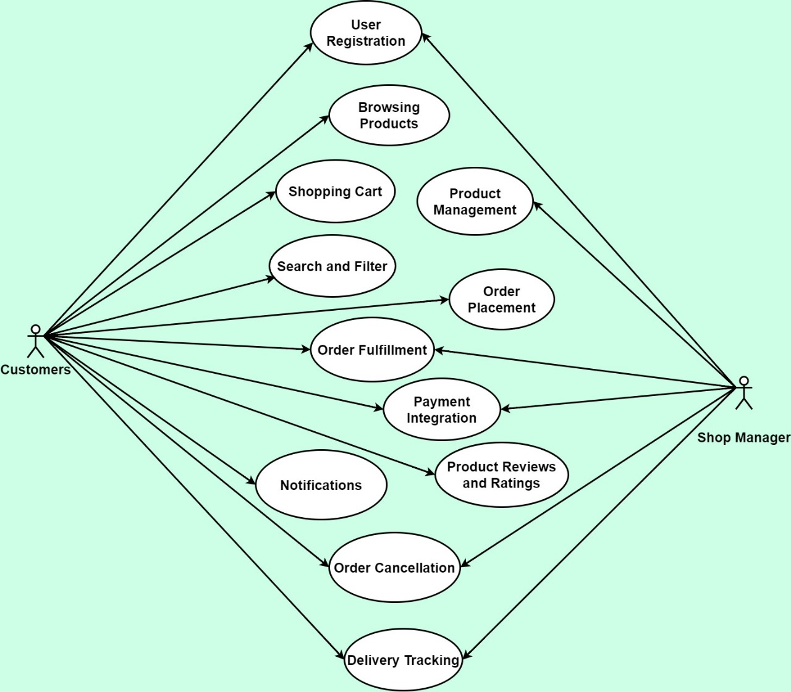
Use Case Diagram

Slide 20
Case Description-01: User Registration
Use Case | User Registration
Goal | Allow users to register in the system.
Preconditions | The user is not registered in the system.
Success End Condition | The user successfully registers and gains access to the system.
Failed End Condition | Registration is unsuccessful.
Primary Actors: Secondary Actors: | Customers
Trigger | The user initiates the registration process.
Description / Main Success Scenario | Step | Action
 | 1 | The user accesses the registration page.
 | 2 | The user provides required information, including name, email address, and password.
 | 3 | The system validates the entered information.
 | 4 | If validation is successful, the system creates a new user account.
 | 5 | The system sends a confirmation email to the user for account verification.
 | 6 | The user clicks the verification link in the email.
 | 7 | The system activates the user account.
Alternative Flows | If the user provides invalid information, the system prompts for corrections.
Quality Requirements | The registration process should be completed within two minutes.

Slide 21
Case Description-02: Product Management
Use Case | Product Management
Goal | Enable shop managers to manage product information.
Preconditions | Shop Manager is logged into the system.
Success End Condition | Product information is successfully updated in the system.
Failed End Condition | Product information is not updated.
Primary Actors: Secondary Actors: | Shop Manager
Trigger | Shop Manager accesses the product management interface.
Description / Main Success Scenario | Step | Action
 | 1 | The Shop Manager accesses the product management interface..
 | 2 | The system displays a list of existing products.
 | 3 | The Shop Manager can add new products, edit existing ones, or remove products.
 | 4 | The Shop Manager updates product details, such as name, description, and price.
 | 5 | The system validates and saves the changes.
Alternative Flows | If the Shop Manager encounters an issue, the system provides error messages.
Quality Requirements | Product information updates should be reflected in real-time.

Slide 22
Case Description-03: Browsing Products
Use Case | Browsing Products
Goal | Allow users to browse and view product information.
Preconditions | User is on the home page or product catalog.
Success End Condition | User has explored product information on the platform.
Failed End Condition | User is unable to access product information.
Primary Actors: Secondary Actors: | Customers
Trigger | User navigates to the product catalog.
Description / Main Success Scenario | Step | Action
 | 1 | The user navigates through product categories or featured items.
 | 2 | The system displays a grid of products with basic information.
 | 3 | The user clicks on a product for detailed information.
 | 4 | The system displays detailed product information, including images, description, and price.
Alternative Flows | The user can refine the product list based on search criteria.
Quality Requirements | Product information should be loaded within three seconds.

Slide 23
Case Description-04: Shopping Cart
Use Case | Shopping Cart
Goal | Enable users to add products to a shopping cart and proceed to checkout.
Preconditions | User is logged in and has selected products for purchase.
Success End Condition | Products are in the user's shopping cart for order placement.
Failed End Condition | Products are not added to the shopping cart.
Primary Actors: Secondary Actors: | Customers
Trigger | User proceeds to checkout from the shopping cart.
Description / Main Success Scenario | Step | Action
 | 1 | The user adds products to the shopping cart.
 | 2 | The system updates the shopping cart total.
 | 3 | The user can view and manage the items in the shopping cart.
 | 4 | The user proceeds to checkout.
Alternative Flows | The user can refine the product list based on search criteria.
Quality Requirements | Product information should be loaded within three seconds.

Slide 24
Case Description-05: Search and Filter
Use Case | Search and Filter
Goal | Allow users to search for products and apply filters.
Preconditions | User is on the product catalog or search page.
Success End Condition | User has a narrowed-down set of products based on search criteria.
Failed End Condition | Search and filtering options are not effective.
Primary Actors: Secondary Actors: | Customers
Trigger | User enters search terms or applies filters.
Description / Main Success Scenario | Step | Action
 | 1 | The user enters search terms or applies filters.
 | 2 | The system updates the product grid based on search criteria.
 | 3 | The user can further refine search results or reset filters.
Alternative Flows | The system suggests autocomplete options based on entered search terms.
Quality Requirements | Search results should be displayed within two seconds.

Slide 25
Case Description-06: Order Placement
Use Case | Order Placement
Goal | Enable users to place an order for selected products.
Preconditions | User has selected products and is ready to make a purchase.
Success End Condition | Order is successfully placed, and the user receives an order confirmation.
Failed End Condition | Order placement is unsuccessful.
Primary Actors: Secondary Actors: | Customers
Trigger | User confirms the order details.
Description / Main Success Scenario | Step | Action
 | 1 | The user proceeds to checkout from the shopping cart.
 | 2 | The system displays the order summary, including selected items and total cost.
 | 3 | The user confirms the order details.
 | 4 | The system prompts the user to choose a delivery address and payment method.
 | 5 | The user provides necessary information for delivery and selects a payment method.
 | 6 | The system validates the information and processes the order.
Alternative Flows | If the user encounters issues during payment, the system provides guidance.
Quality Requirements | Order processing should take no longer than five seconds.

Slide 26
Case Description-07: Payment Integration
Use Case | Payment Integration
Goal | Integrate secure payment processing for user transactions.
Preconditions | User is at the checkout stage, and payment information is required.
Success End Condition | Payment is successfully processed, and the order is confirmed.
Failed End Condition | Payment processing is unsuccessful, and the order is not confirmed.
Primary Actors: Secondary Actors: | Customers
Trigger | User selects a payment method during the checkout process.
Description / Main Success Scenario | Step | Action
 | 1 | The user selects a payment method during the checkout process.
 | 2 | The system redirects the user to the chosen payment gateway.
 | 3 | The user enters payment details and confirms the transaction.
 | 4 | The payment gateway processes the transaction and sends a confirmation to the system.
 | 5 | The system updates the order status to "Paid."
Alternative Flows | If payment authorization fails, the system prompts the user to retry or choose an alternative method.
Quality Requirements | Payment processing should take no longer than ten seconds.

Slide 27
Case Description-08: Product Reviews and Ratings
Use Case | Product Reviews and Ratings
Goal | Allow registered customers to submit reviews and ratings for products.
Preconditions | User has purchased a product.
Success End Condition | Product has updated reviews and ratings.
Failed End Condition | Product reviews and ratings are not updated.
Primary Actors: Secondary Actors: | Customers
Trigger | User accesses the product details page.
Description / Main Success Scenario | Step | Action
 | 1 | The user accesses the product details page.
 | 2 | The system displays options to leave a review and provide a rating.
 | 3 | The user submits a review and assigns a rating to the product.
 | 4 | The system updates the product's overall rating and displays the review.
Alternative Flows | If the user decides not to submit a review, the system retains the previous ratings.
Quality Requirements | Reviews and ratings should be processed and updated in real-time.

Slide 28
Case Description-09: Notifications
Use Case | Notifications
Goal | Keep users informed about important events and updates.
Preconditions | Relevant events or actions trigger notifications.
Success End Condition | Users receive timely notifications about important events.
Failed End Condition | Users do not receive notifications.
Primary Actors: Secondary Actors: | Customers Shop Manager
Trigger | System generates notifications for order updates, promotions, or other relevant information.
Description / Main Success Scenario | Step | Action
 | 1 | The system generates notifications for order updates, promotions, or other relevant information.
 | 2 | Notifications are sent to the respective users via email, in-app messages, or push notifications.
 | 3 | Users can view and manage notifications in their account settings.
Alternative Flows | Users can customize their notification preferences in the system settings.
Quality Requirements | Notifications should be delivered within one minute of the triggering event.

Slide 29
Case Description-10: Order Cancellation
Use Case | Order Cancellation
Goal | Enable customers or Shop Manager to cancel orders within a specified timeframe and ensure inventory and financial adjustments are handled efficiently.
Preconditions | Customer is logged into their account, and the order is within the cancellable timeframe.
Success End Condition | The order is successfully canceled, inventory is updated, and a refund is initiated if applicable.he user successfully registers and gains access to the system.
Failed End Condition | The order remains active, inventory and financial records are unchanged.
Primary Actors: Secondary Actors: | Customers Shop Manager
Trigger | Customer initiates the cancellation process for an order.
Description / Main Success Scenario | Step | Action
 | 1 | Customer accesses their order history.
 | 2 | System displays list of recent orders with options.
 | 3 | Customer selects cancellation for an eligible order.
 | 4 | System asks for confirmation.
 | 5 | Customer confirms.
 | 6 | System checks eligibility and updates status.
 | 7 | Inventory adjusted; refund initiated.
 | 8 | Customer receives confirmation.
Alternative Flows | a | Order not in cancellable timeframe - system informs customer.
 | b | Product type not cancellable - customer notified.
 | c | Technical issue with adjustments - Shop Manager notified.
Quality Requirements | Simple and intuitive cancellation process Real-time processing of inventory updates and refunds Clear feedback to customer during process Security measures to prevent fraud

Slide 30
Case Description-11: Delivery Tracking
Use Case | Delivery Tracking
Goal | Allow users to track the real-time status of their deliveries.
Preconditions | Order is in the "Out for Delivery" status.
Success End Condition | Users can track the real-time status of their deliveries.
Failed End Condition | Users cannot track the delivery status.
Primary Actors: Secondary Actors: | Customer Shop Manager
Trigger | Order is in the "Out for Delivery" status.
Description / Main Success Scenario | Step | Action
 | 1 | The system provides a real-time tracking interface for the registered customer.
 | 2 | The Delivery Man updates the delivery status upon successful completion.
Alternative Flows | If the delivery is delayed, the system provides updated estimated delivery times.
Quality Requirements | Delivery status updates should be real-time.

Slide 31
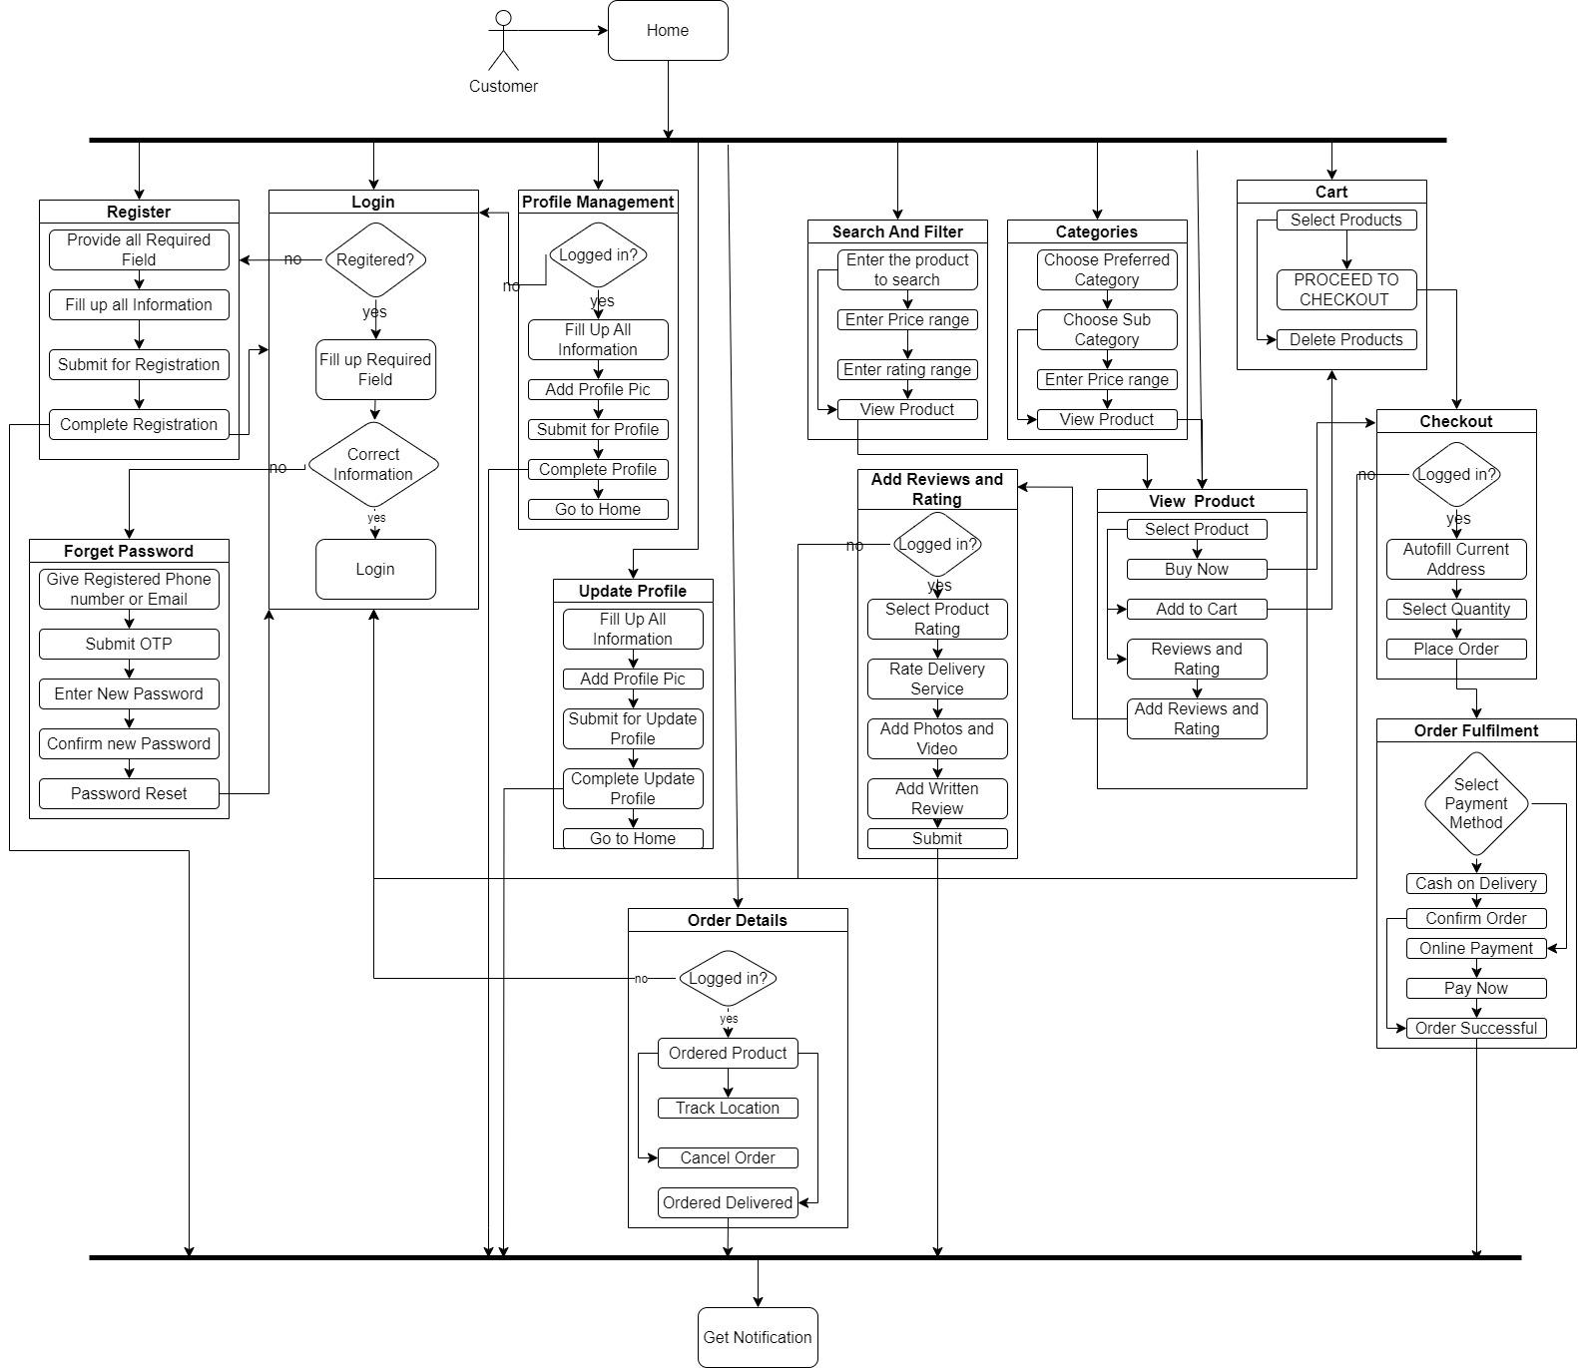
Block Diagram-1: Customer

Slide 32
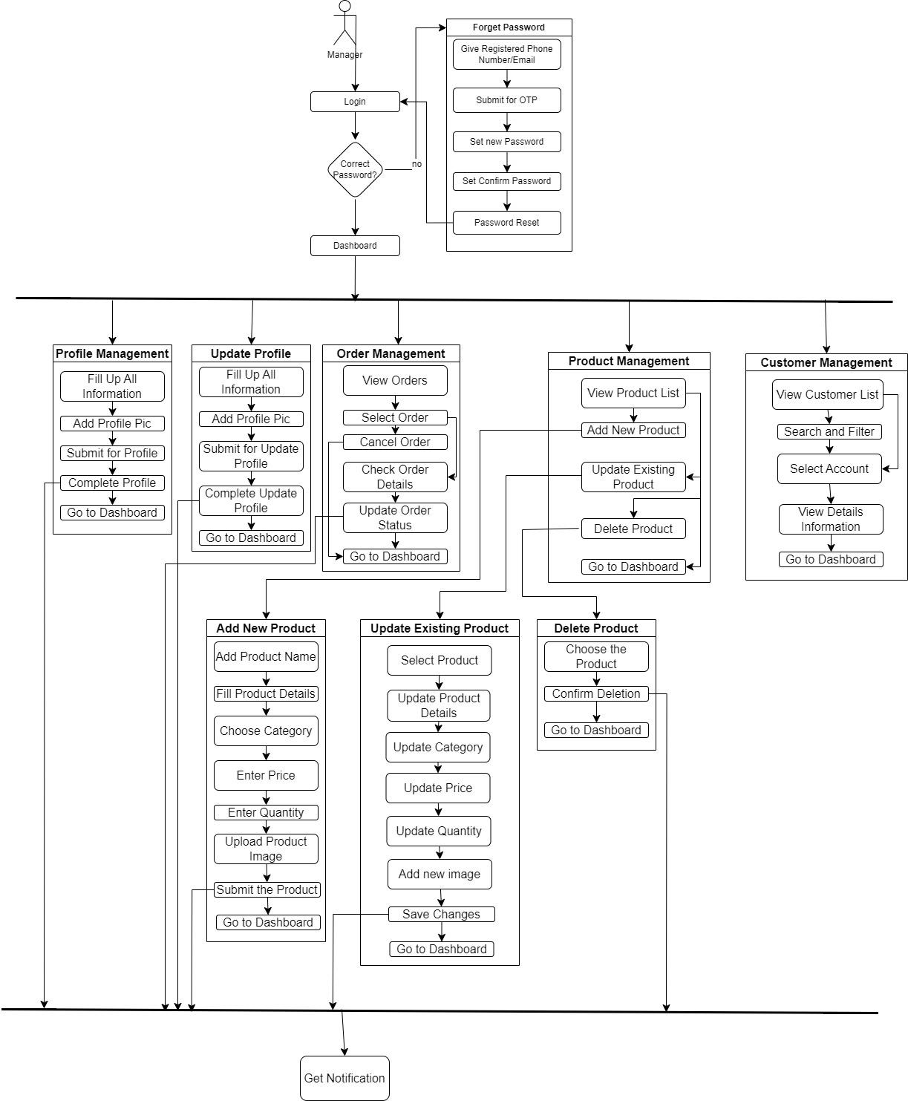
Block Diagram-2: Manager

Slide 33
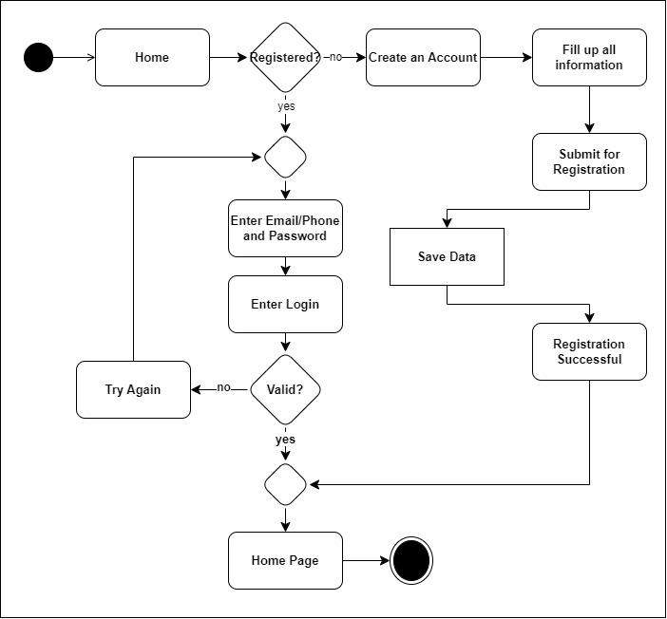
Activity Diagram-1: User Registration and Login

Slide 34
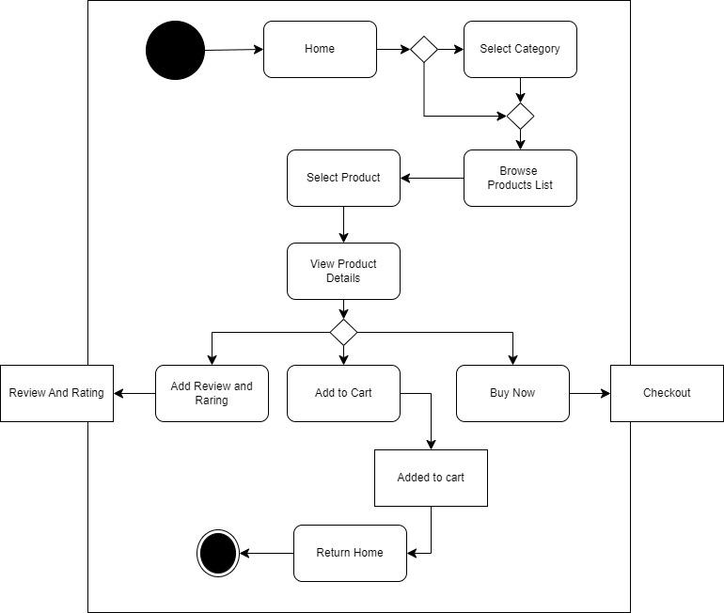
Activity Diagram-2: Browsing and View Product

Slide 35
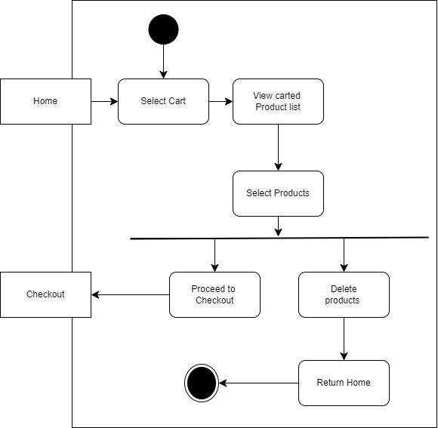
Activity Diagram-3: Shopping Cart

Slide 36
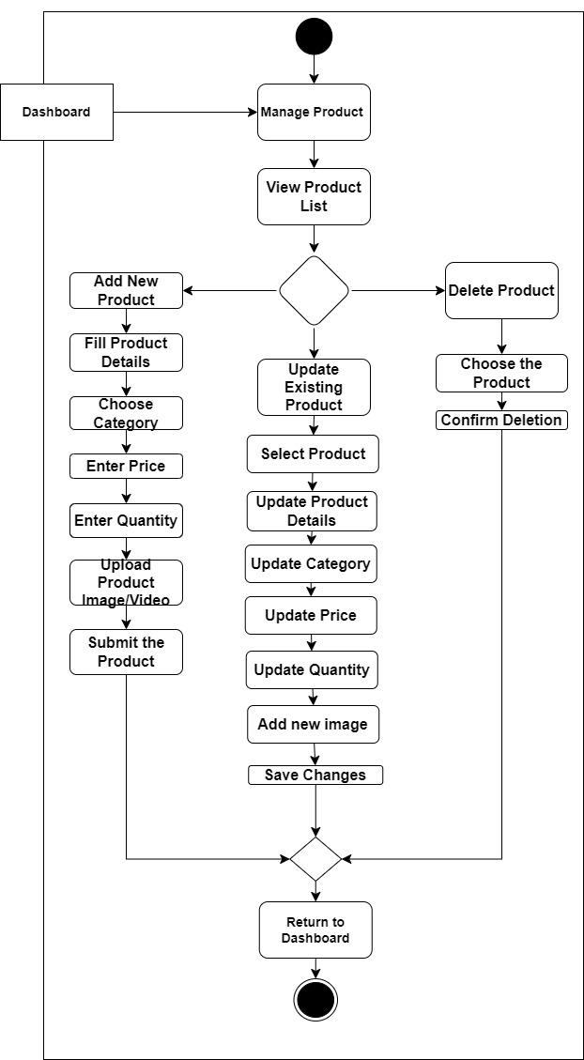
Activity Diagram-4: Product Management

Slide 37
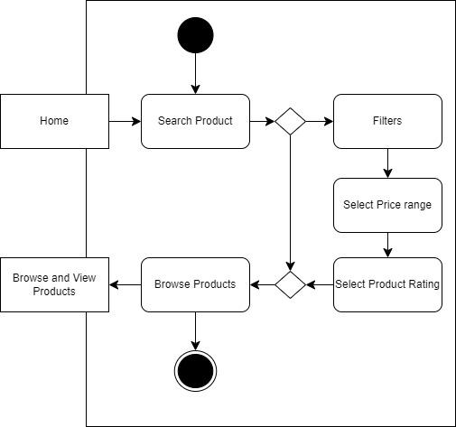
Activity Diagram-5: Search and Filter

Slide 38
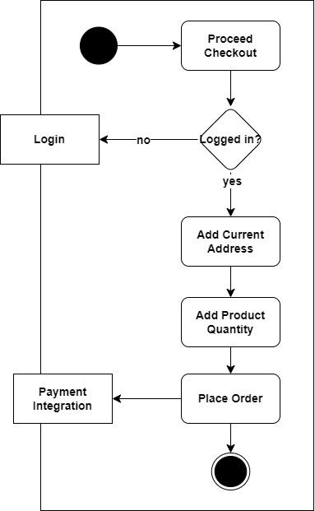
Activity Diagram-6: Order Placement

Slide 39
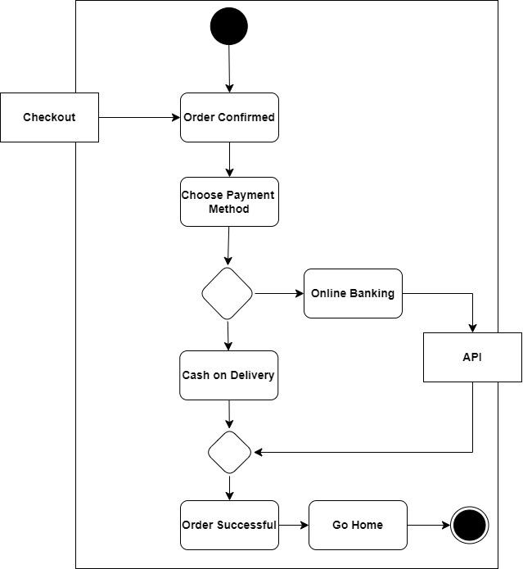
Activity Diagram-7: Payment Integration

Slide 40
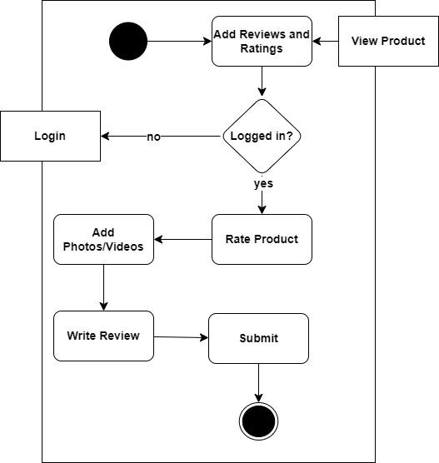
Activity Diagram-8: Product Reviews and Ratings

Slide 41
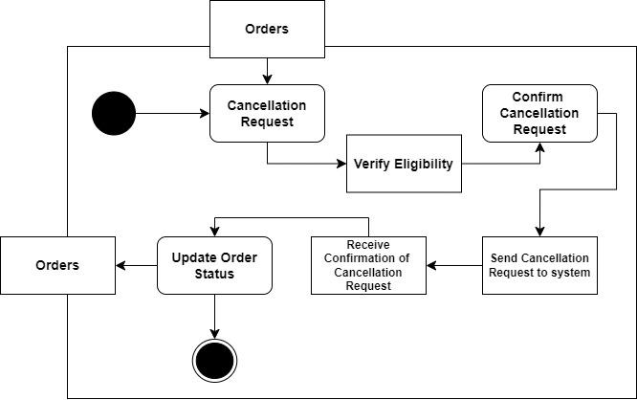
Activity Diagram-9: Order Cancellation

Slide 42
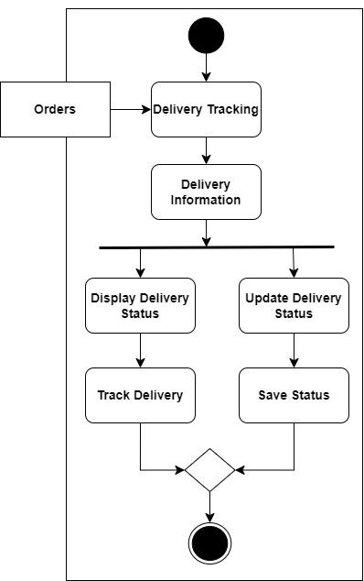
Activity Diagram-10: Delivery Tracking

Slide 43
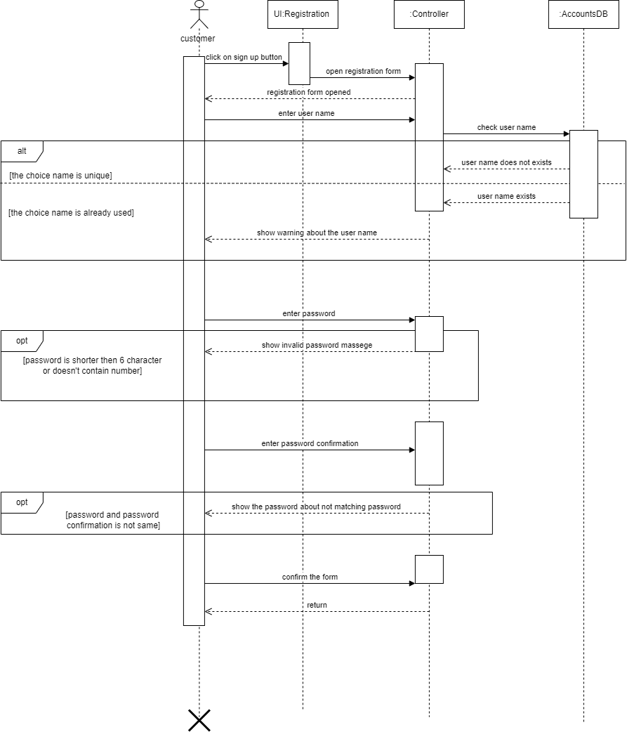
Sequence Diagram-1: User Registration

Slide 44
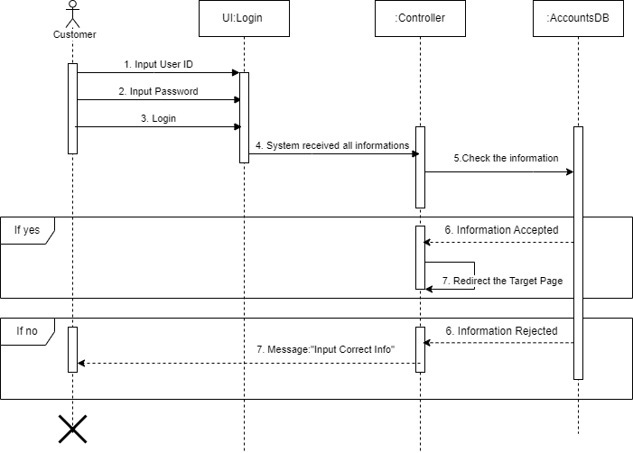
Sequence Diagram-2: User Login

Slide 45
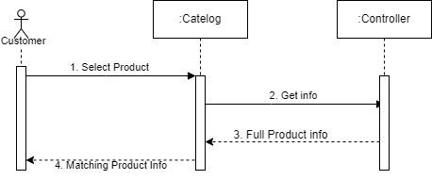
Sequence Diagram-3: View Product

Slide 46
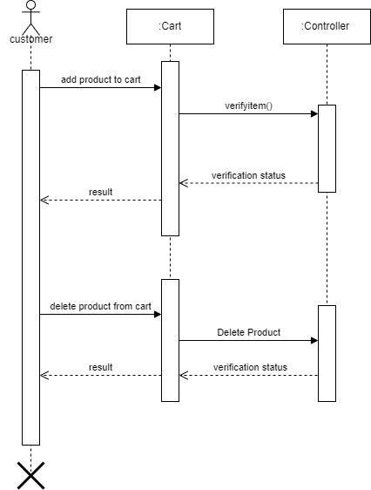
Sequence Diagram-4: Shopping Cart
o

Slide 47
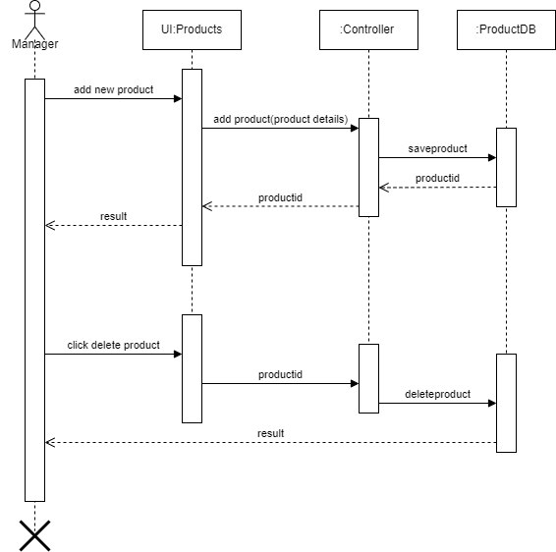
Sequence Diagram-5: Product Management

Slide 48
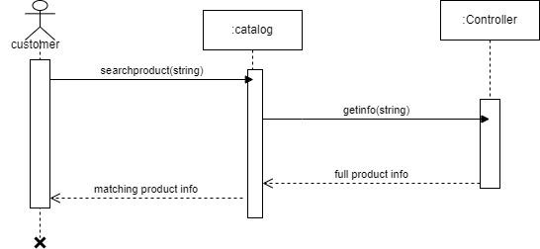
Sequence Diagram-6: Search Product

Slide 49
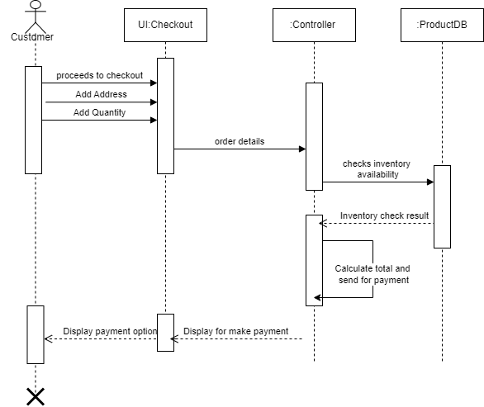
Sequence Diagram-7: Order Placement

Slide 50
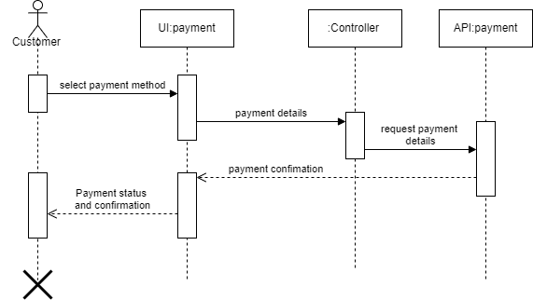
Sequence Diagram-8: Payment Integration

Slide 51
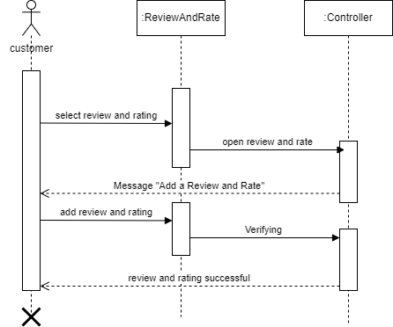
Sequence Diagram-9: Product Reviews and Ratings

Slide 52
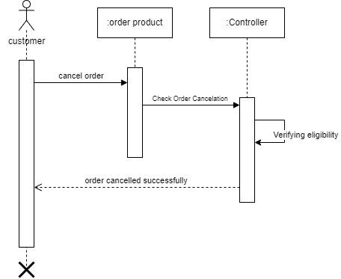
Sequence Diagram-10: Order Cancellation

Slide 53
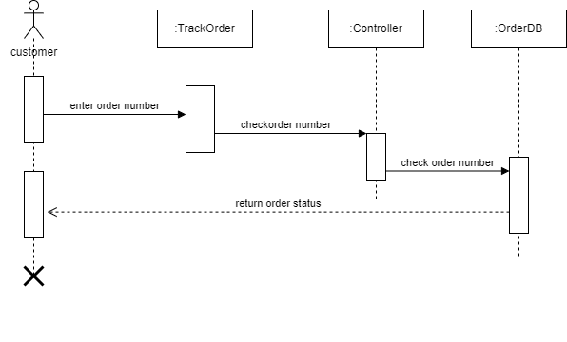
Sequence Diagram-11: Delivery Tracking

Slide 54
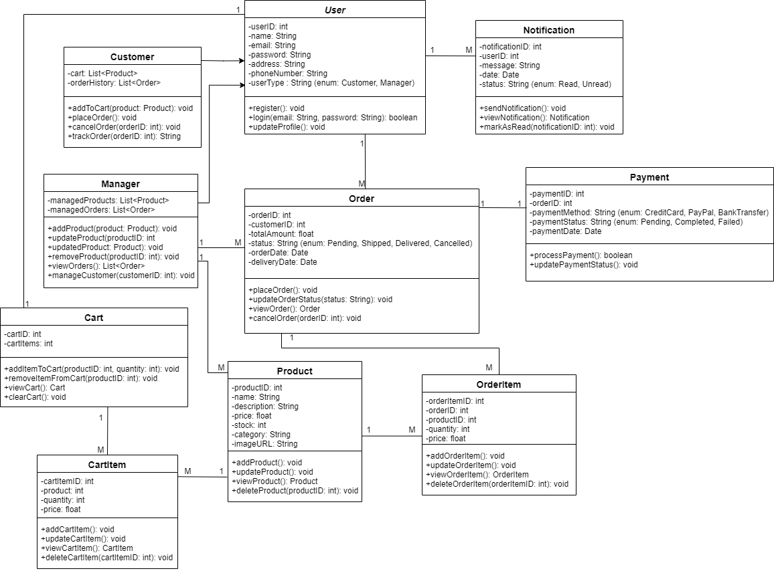
Class Diagram

Slide 55
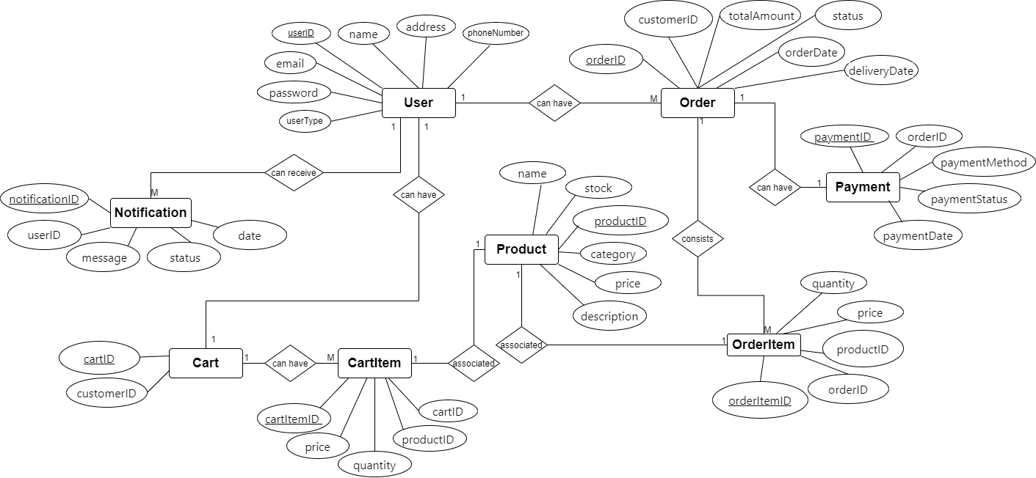
ER Diagram

Slide 56
Thank You
Any Question?

